Slide 1
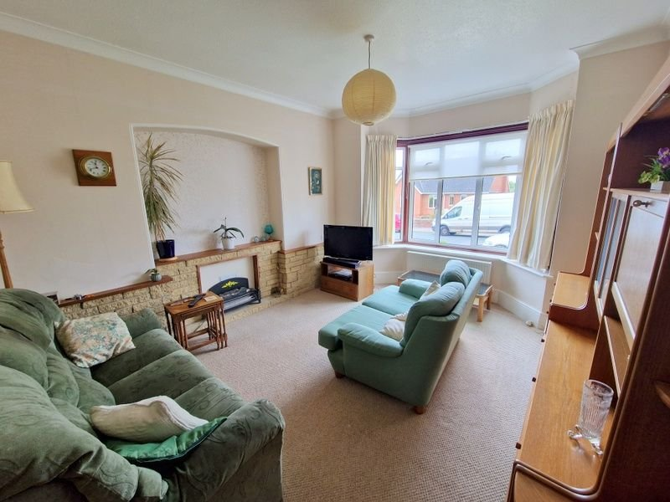
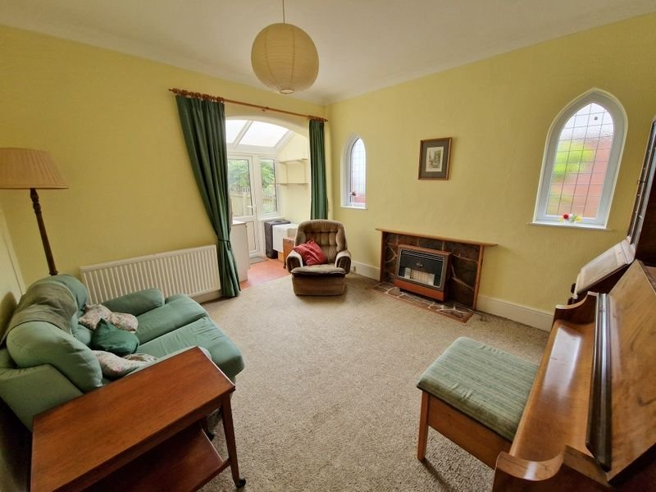
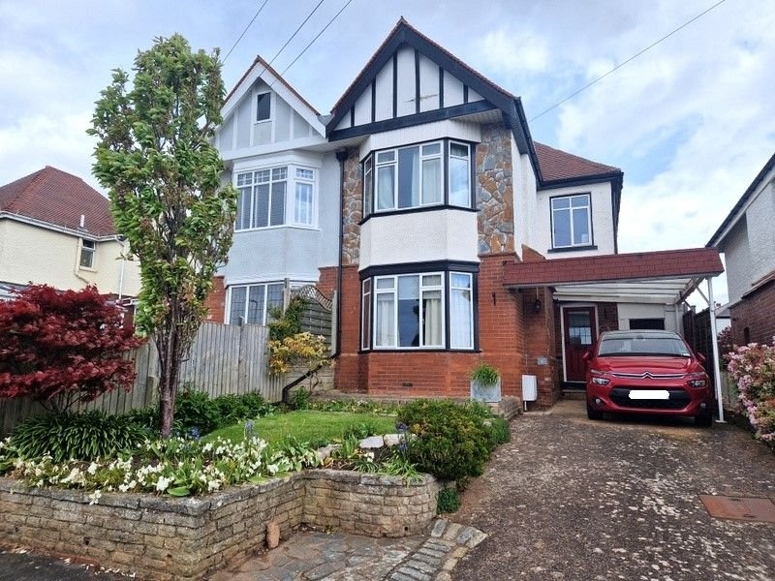
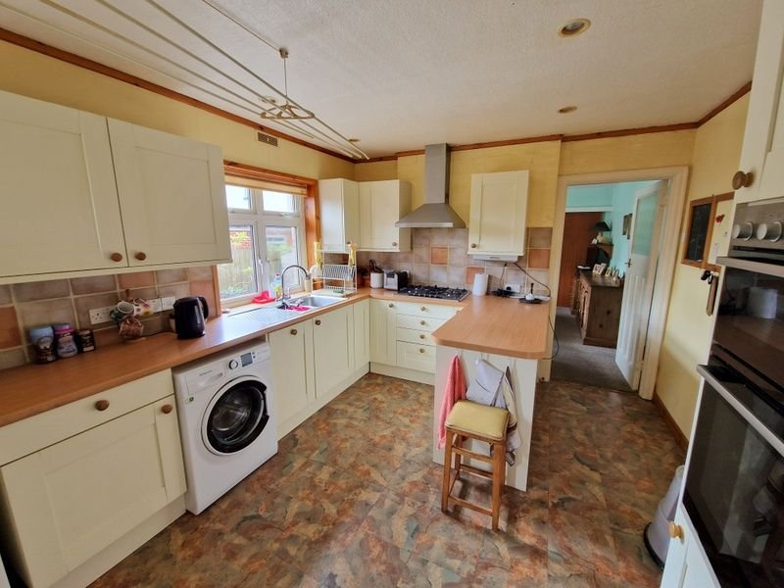
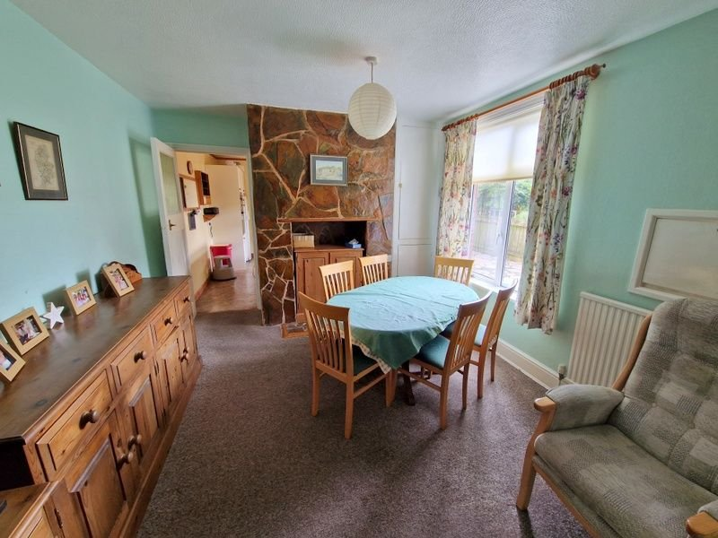
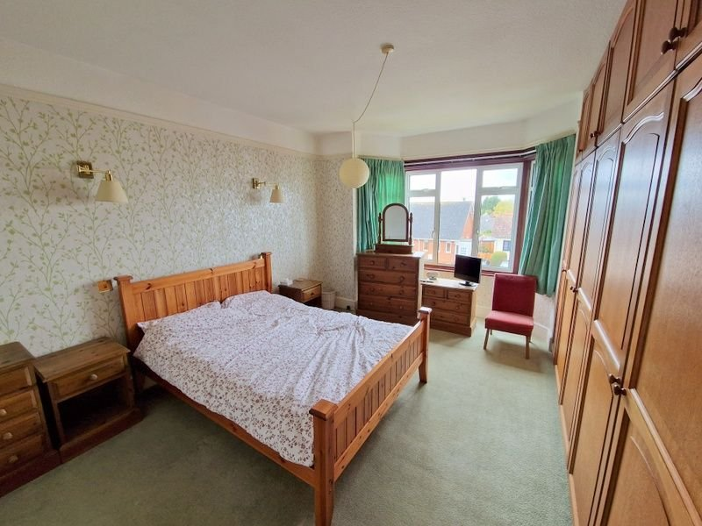
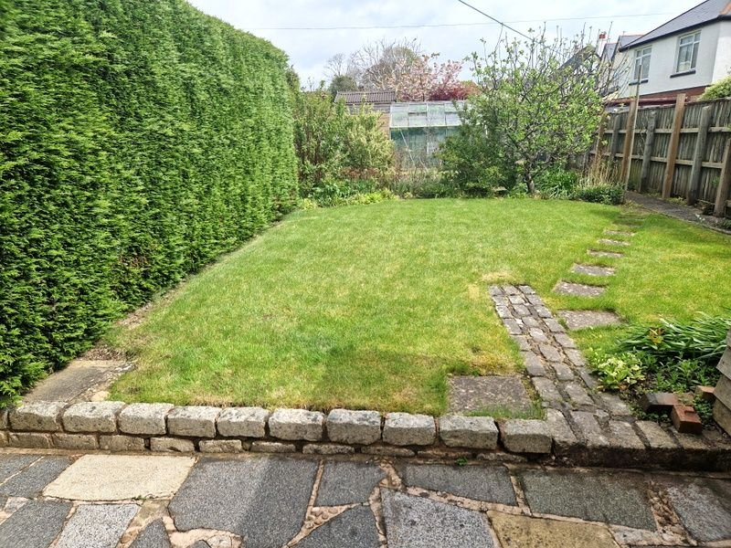
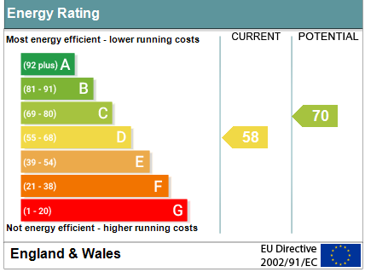
www.pennys.net
6 Belle Vue Road, Exmouth, EX8 3DR
GUIDE PRICE £550,000
TENURE Freehold
A Most Attractive Period Semi Detached Four Bedroom House Located In A Most Favourable Location With Lovely Garden, Driveway And Carport.
Entrance Vestibule & Reception Hall * Lounge * Sitting Room * Dining Room * Kitchen/breakfast Room * Cloakroom/WC * Four Bedrooms * Spacious Bathroom & Separate/WC * Some Fine Period Features * Gas Central Heating & Double Glazed Windows * Superb Family Home *
No Onward Chain *
Pennys Estate Agents Limited for themselves and for the vendor of this property whose agents they are give notice that:- (1) These particulars do not constitute any part of an offer or a contract. (2) All statements contained in these particulars are made without responsibility on the part of Pennys Estate Agents Limited. (3) None of the statements contained in these particulars are to be relied upon as a statement or representation of fact. (4) Any intending purchaser must satisfy himself/herself by inspection or otherwise as to the correctness of each of the statements contained in these particulars. (5) The vendor does not make or give and neither do Pennys Estate Agents Limited nor any person in their employment has any authority to make or give any representation or warranty whatever in relation to this property.
PENNYS ESTATE AGENTS
2 Rolle House, Rolle Street, Exmouth, Devon, EX8 2SN
Tel: 01395 264111 EMail: help@pennys.net

Slide 2
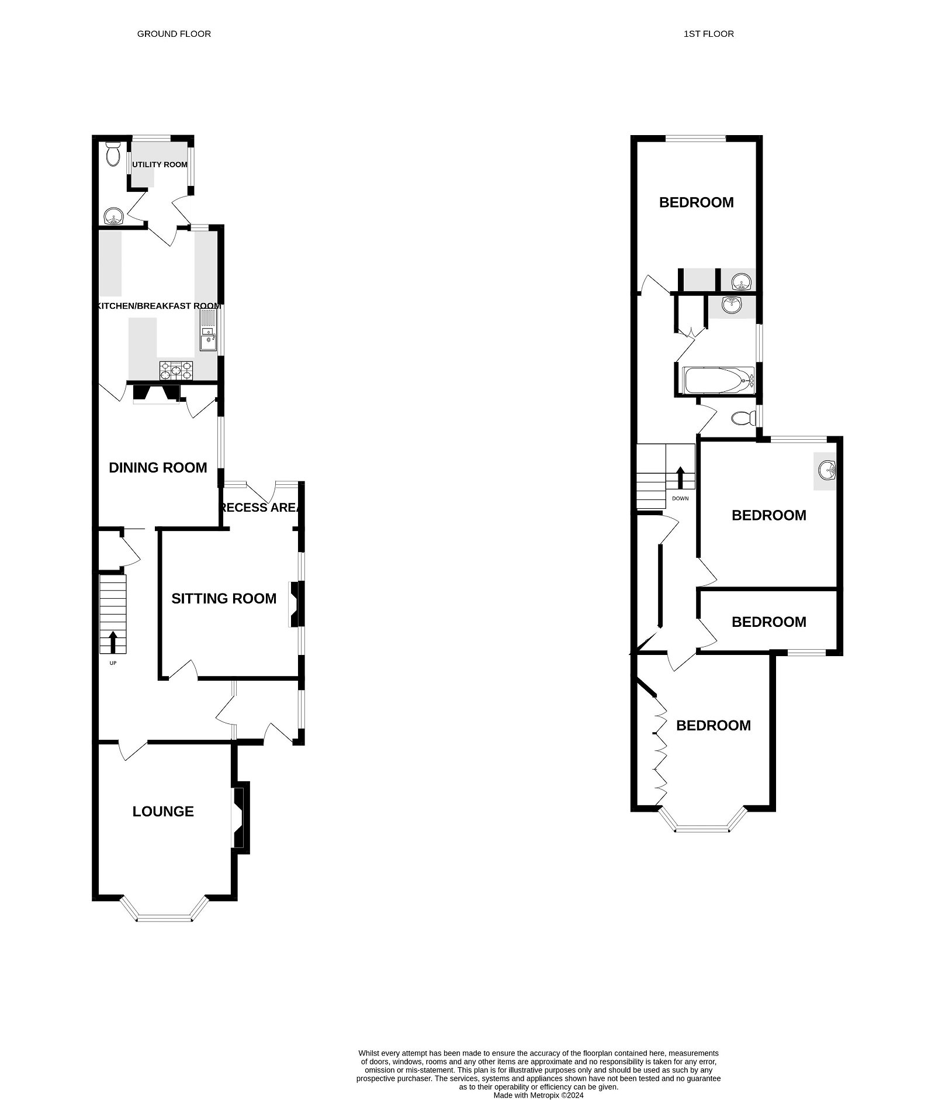
6 Belle Vue Road, Exmouth, EX8 3DR
THE ACCOMMODATION COMPRISES: Composite front door to:
ENTRANCE VESTIBULE: 5’9” x 5’5”: Tiled floor; cupboard housing meters, double glazed window with pattern glass; inner solid wood door with stain glass window and matching window side screens to:
RECEPTION HALL: A fine entrance to the property with picture rail. Radiator. Stairs to first floor landing with original newell post, understairs cupboard.
LOUNGE: 15’7” x 11’11”: Double glazed window to front aspect. Stone fireplace with wood mantle over. TV point. Radiator.
SITTNG ROOM: 12’11” x 12’3”: Two double glazed arched picture windows with pattern glass. Radiator. Gas fire with slate hearth and wood mantle over. Archway with curtain divider to: Recess Area: 6’8” x 4’9”: Cupboard with display surface over. Double glazed windows and door to rear garden. Serving hatch to dining room. Polycarbonate roof.
DINING ROOM: 12’11” x 10’10”: Radiator. Double glazed window to side aspect, slate stone chimney breast, chimney recess with matching hatch. Cupboard housing boiler. TV point.
KITCHEN/BREAKFAST ROOM: 12’7” x 10’10”: With wood effect worktops extended to provide breakfast bar area with cupboards and drawers, units, plumbing for automatic washing machine under and tiled surrounds, built-in oven and grill. Built-in narrow dishwasher. Five ring hob with stainless steel chimney style extractor hood over, wall mounted cupboards, double glazed window to side and rear aspects. Space for upright fridge and freezer. Recessed ceiling spot lighting. Part glazed door to:
UTILITY ROOM: 8’.0 X 4’9”: Wood effect work tops with cupboards under, double glazed windows and door to rear garden, tiled floor. Door to:
CLOAKROOM/WC: Pedestal wash hand basin, tiled splashback wall, WC, extractor fan, window with pattern glass.
FIRST FLOOR LANDING: Access to linen cupboard. Glass roof hatch to spacious loft space. Picture rail.
BEDROOM 1: 15’5” x 11’11”: Double glazed window to front aspect, built-in range of wardrobes with cupboards over. Radiator. Picture rail.
BEDROOM 2: 12’2” x 11’5”: Double glazed window to rear aspect. Vanity wash hand basin with tiled splashback. Two radiators. Picture rail.
BEDROOM 3: 13’10” x 11’1”: Double glazed window to rear aspect. Radiator. Vanity wash hand basin with tiled splashback. Chimney recess with fitted dressing table area with mirror and light over.
BEDROOM 4: 12’3” x 7’: Double glazed window to front aspect with Estuary glimpses. Radiator.
BATHROOM: 8’7”x 7’6”: Fitted with bath, curved shower screen with chrome shower unit over. Wash hand basin set into display surface with cupboards under, mirror and fitted cupboards over with display lighting. Airing cupboard with water tank and slatted shelving. Chrome heated towel rail. Recessed ceiling spot lighting. Double glazed window with pattern glass.
SEPARATE WC: With WC, radiator, double glazed window with pattern glass.
OUTSIDE: Lawned front garden edged with colourful flower beds, block paved terrace, driveway and carport with pedestrian door giving access to the rear garden.
The rear garden is a wonderful feature of the property with patio sun terrace area ideal for outside entertaining, timber shed plus small lean-to-shed, level lawn garden, vegetable plot, fruit trees, greenhouse with Vine. Further timber shed at rear of garden. Outside tap.
FLOOR PLAN:

